Slide 1
Zakir Husain College of Engineering and Technology
AIP3192
Detection of Unplanned Urban Development Deviation
using multi-approaches for Analysis of Government Plan Maps and Satellite Imagery
Presented By:
Aryan Parashar — 23AIBEA214
Prakhar Saxena — 23AIBEA187
Under Guidance of:
Nadia Ma’am
Interdisciplinary Centre for Artificial Intelligence
Aligarh Muslim University

Slide 2
Motivation
Rapid urban expansion and mismanagement
Unauthorized construction ➜ traffic, environmental stress
Manual inspections: slow & inaccurate
Need for automated compliance monitoring

Slide 3
Contents
Problem definition
Research Objectives
Study Area
Proposed Approaches:
I) K-Means on Plan Maps
II) U-Net for Feature Extraction
Image Alignment / Tiling
SSIM for Deviation Detection
Results
User Interface / Project Demo

Slide 4
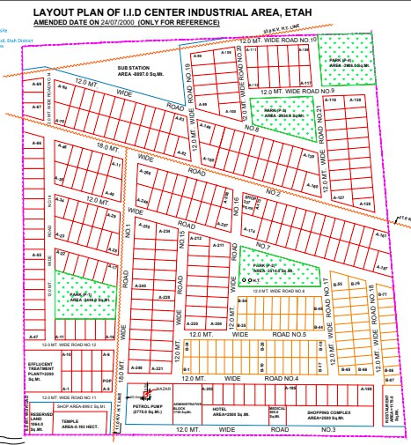
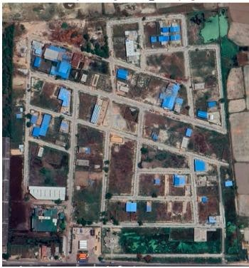
Problem Definition
Compare:
Govt-approved development map vs Actual development from satellite imagery
→ Detect deviations & quantify compliance
Fig.1: Layout Plan and Satellite image of I.I.D CENTER INDUSTRIAL AREA, Etah

Slide 5
Research Objectives
Automate plan map processing
Segment buildings & roads from satellite imagery
Align two maps spatially
Quantify development deviation

Slide 6
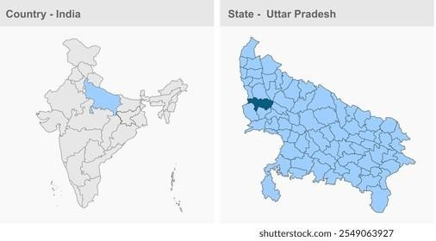
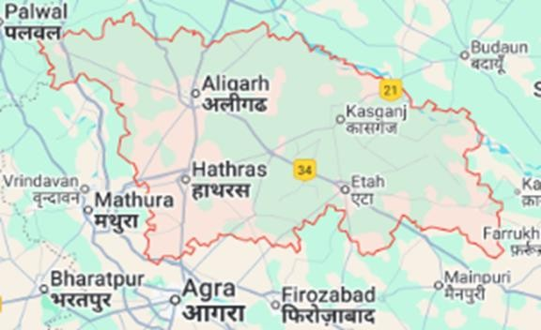
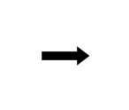
Study Area
Aligarh Division, Uttar Pradesh
Fig.2: Location of area under study
Focusing on major residential & industrial sites
Development sites (1991–2023) Industrial + Residential projects

Slide 7
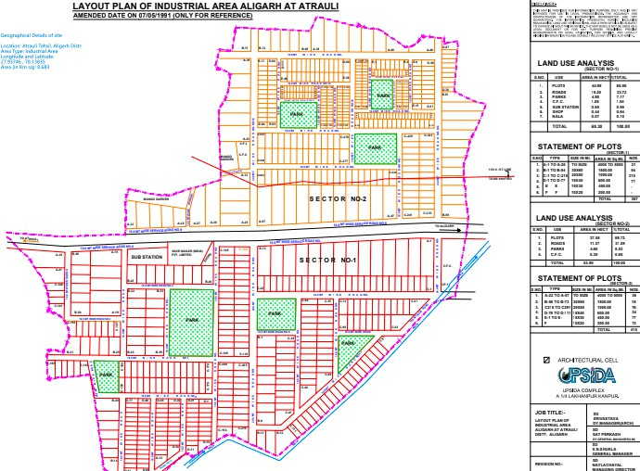
All the maps are either taken from their official website or State govt official website(UPSIDA).
Aligarh District:
Atrauli Industrial Area (1991) CDF chharat (2009)
Swarn Jayanti Nagar (2013)
Talanagari (2014)
Sagvan City (2017)
Ozone City (2005)
Hathras District:
Salempur (2023)
Etah District:
IA Etah (2002)
IID Center (2005)
Orni (2022)
Uploaded here: https://drive.google.com/file/d/1UuyCFHQ8w_zMNey- PbL13luKCFGhjRN8/view?usp=sharing
Fig.3: Layout Plan of Atrauli, its details from UPSIDA Website [5]

Slide 8
Proposed Approaches
K-Means Clustering
Text Removal
Color reduction (3–7 clusters)
Grayscale conversion
U-Net Semantic Segmentation (Approaches)
Directly using Unet model trained on USA Dataset
Using Unet model trained on Alig Dataset
Using Transfer learning

Slide 9
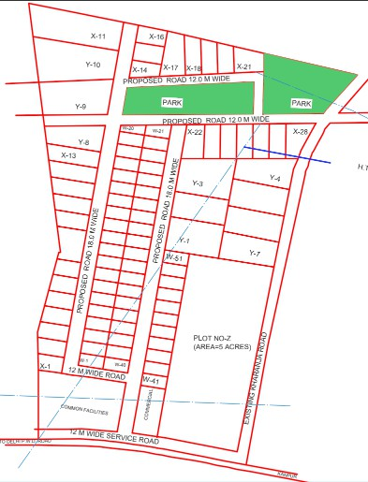
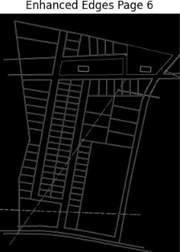
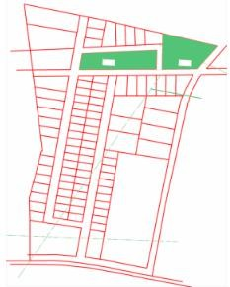
Approach 1: K-Means on Plan Maps
Tasks:
Text Removal
Color reduction (3–7 clusters)
Grayscale conversion
Original Image After Text remove
After Grayscale
Fig.5: Approach 1 on IA Etah Map

Slide 10
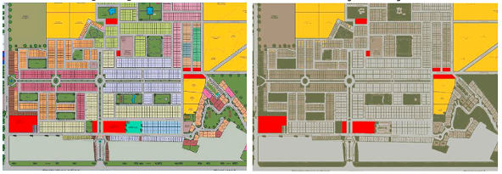
Color reduction Results (K number of color clusters):
Fig.6: K means Clustering effect on “Ozone City” Layout Map
(original many colors {in left} and after k means only 5 colors {in right})

Slide 11
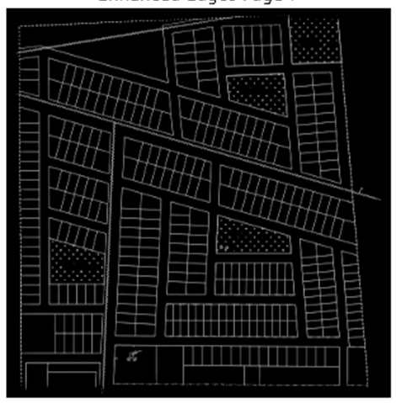
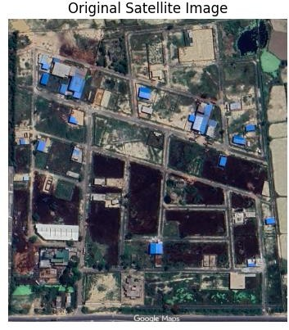
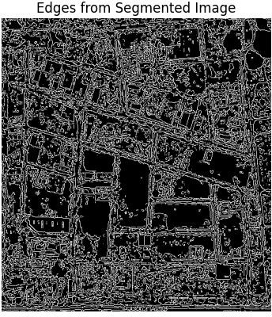
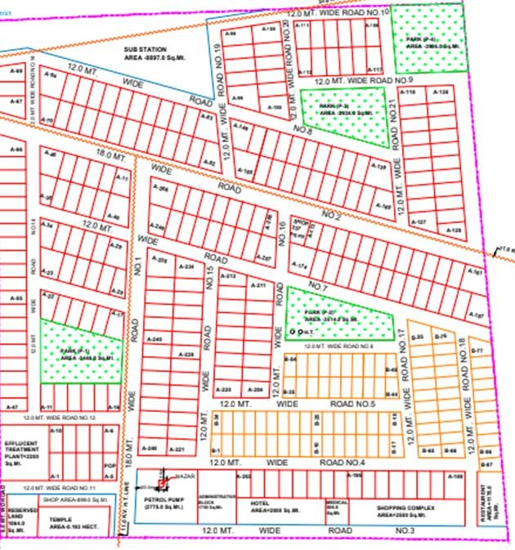
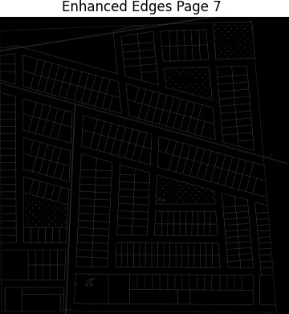
Result
Great results on layout maps
Grayscale clearly show the boundary lines
as in proposed map.
Poor results in Satellite images
Because of noise in satellite images boundary are not clear here.
Layout
Fig 7. Approach 1 Results
Take aways: Layout are done
Search for appropriate technique for satellite images

Slide 12
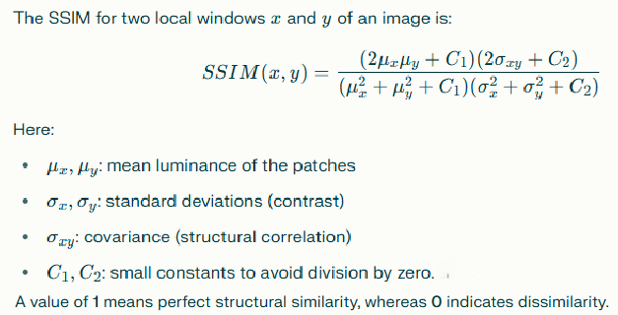
Image Alignment
We have taken the image as 512*512 pixel then breaking
both of them into “n*n” size of tiles (n is user input) .
Then comparing each pixel of each tile by using SSIM
(Structural Similarity Index Measure)
If the value is lesser than certain threshold(0.4), than pixel will be classified as dissimilar.
Fig.8: Formula used for SSIM, mentioned in research paper [2]

Slide 13
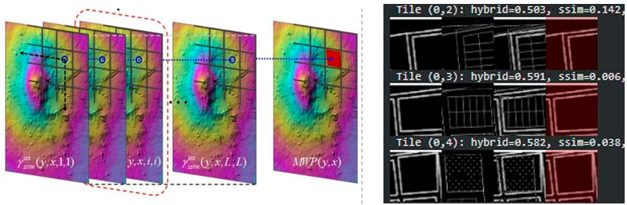
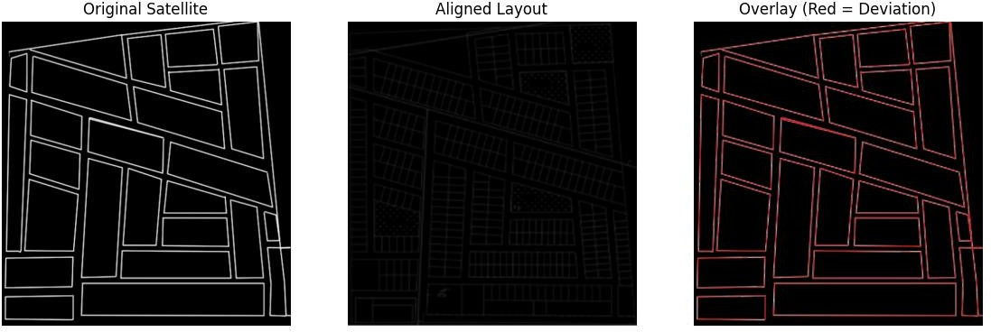
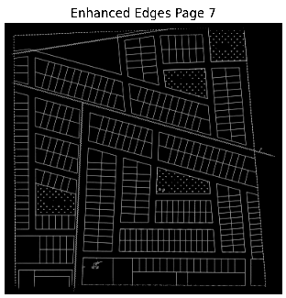
SSIM for Deviation Detection
Compare each pixel of each tile with respective to tile’s pixel in other image map.
Deviation value
<0.3 → High compliance
0.4–0.6 → Moderate
>0.7 → Major deviations
Fig.9: Tilling mention as in research paper [2] (on left) and our implementation (on right)

Slide 14
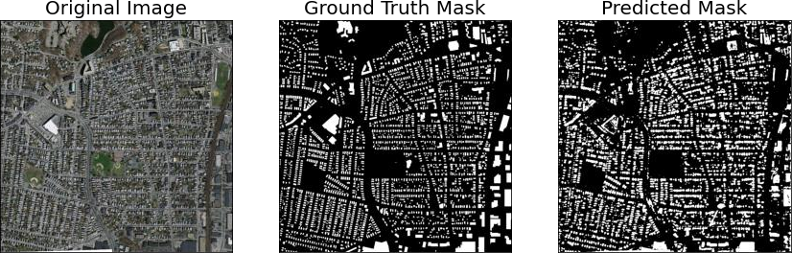
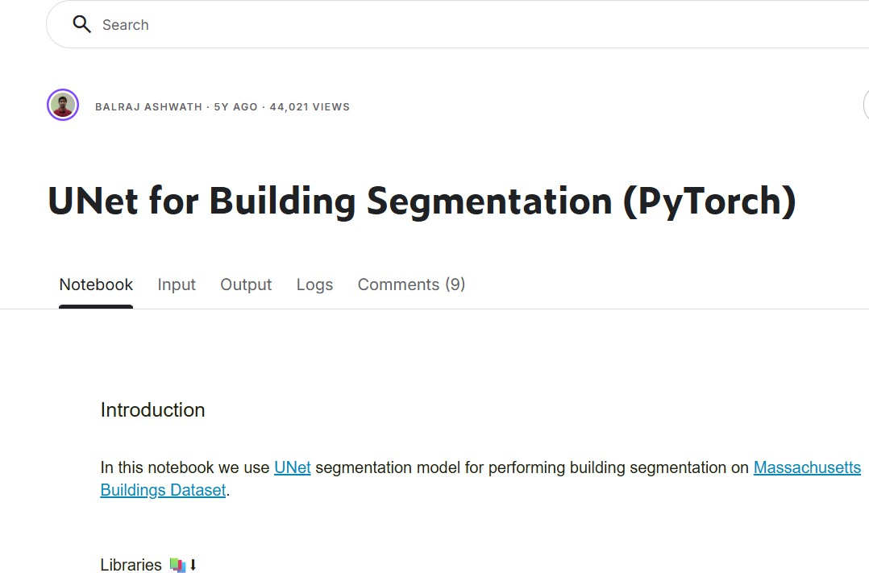
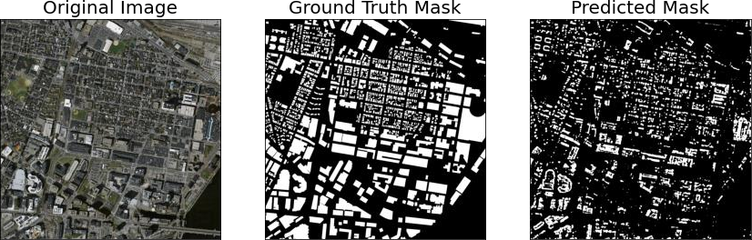
Approach 2: U-Net for Feature Extraction
Idea: UNet for Building Segmentation (PyTorch)
Fig.10: Unet model given in research paper [3] URBAN CHANGE DETECTION
https://www.kaggle.com/code/balraj98/unet-for-building-segmentation-pytorch

Slide 15
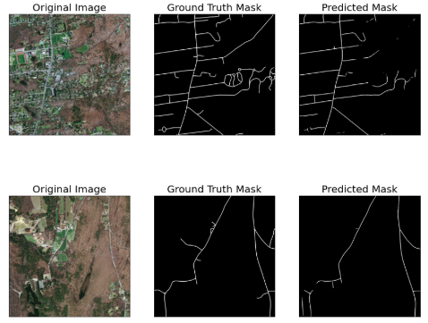
U-Net Model Implementation.
Massachusetts Buildings Dataset
Aerial Images of Boston City to aid Machine
Learning for Aerial Image Labeling
(https://www.kaggle.com/datasets/balraj98/m assachusetts-buildings-dataset)
Trained the model on Massachusetts Buildings Dataset and inference on Aligarh satellite maps.
Unsatisfactory Results
Fig.11: Massachusetts Dataset

Slide 16
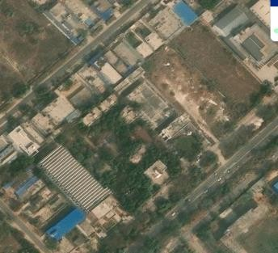
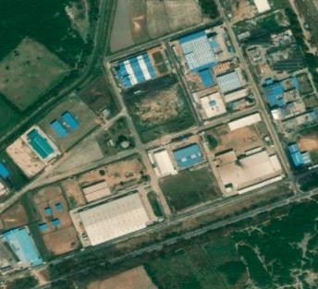
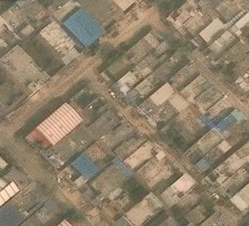
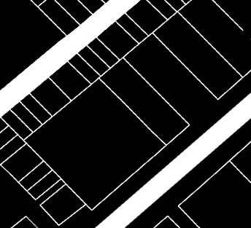
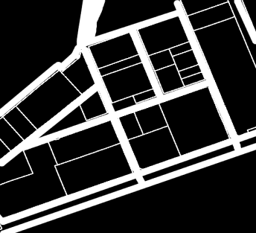
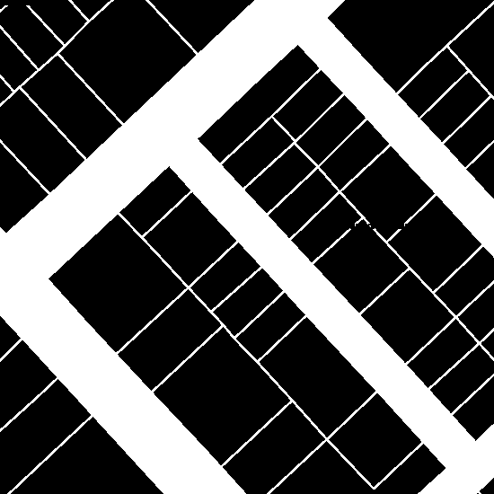
Dataset Used
Aligarh Dataset –
53 satellite images and their masks (with roads, without roads, buildings edges and other variations)
550*550 pixel images of 100m x 100m area.
Hand Labelled by us - Create binary masks for roads and Building edges.
Fig.12: Alig Dataset
Uploaded here.
https://drive.google.com/drive/folders/1bCpjt5gj1pcKABma2espjTPzSGuPFwtA?usp=sharing

Slide 17
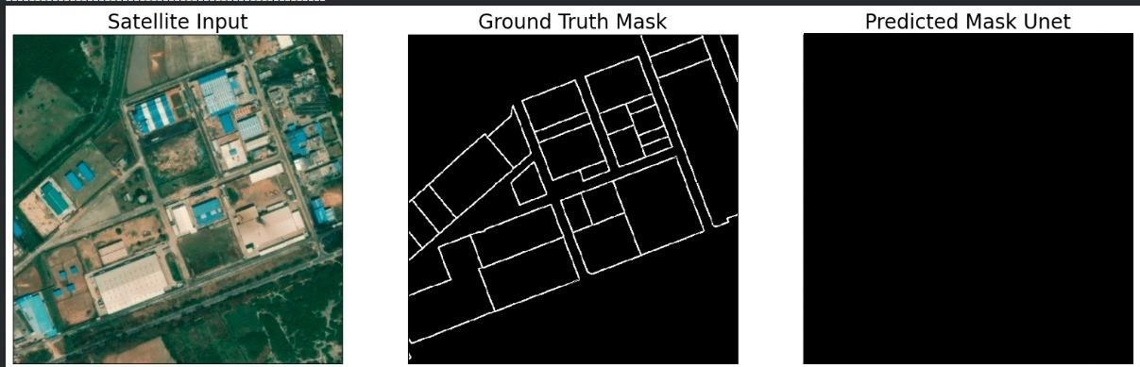
U-Net Model Implementation
Output:
Fig.13:
Outcome: Model fail on local Aligarh maps
Problem : Model only learned to output majority class(i.e. Black Pixels)
Accuracy 98% (because 98% of the Ground truth labels are black)

Slide 18
We used a U-Net with a ResNet-50 encoder.
Modern U-Net variant with a ResNet-50 encoder backbone.(Transfer Learning)
The encoder extracts hierarchical features, and the decoder performs upsampling with skip connections to preserve spatial detail.
Architecture.
Encoder: ResNet-50 (5 stages: 64 → 256 → 512 → 1024 → 2048)
Decoder: 5 upsampling blocks with skip connections
Each block: Upsample ×2 → Concat → 2×Conv(3×3) + ReLU
Input: 3-channel satellite image
Output: 2-class mask (background, building/road)
Strength: Preserves fine edges + captures high-level structure
This setup is ideal for pixel-level extraction of urban structures from satellite
images.

Slide 19
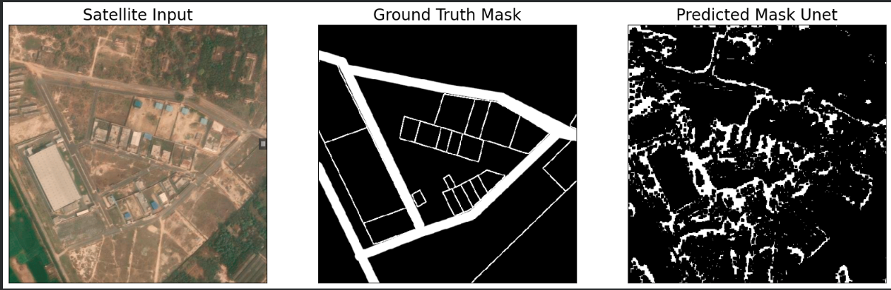
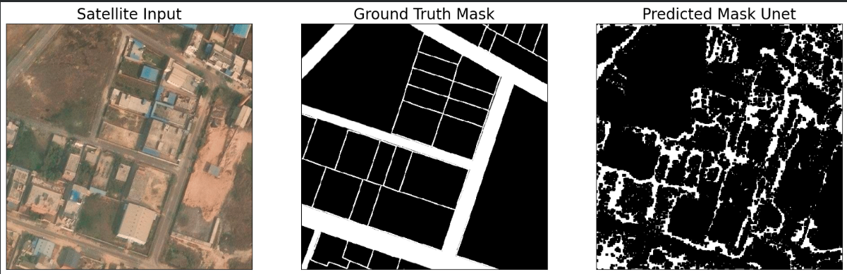
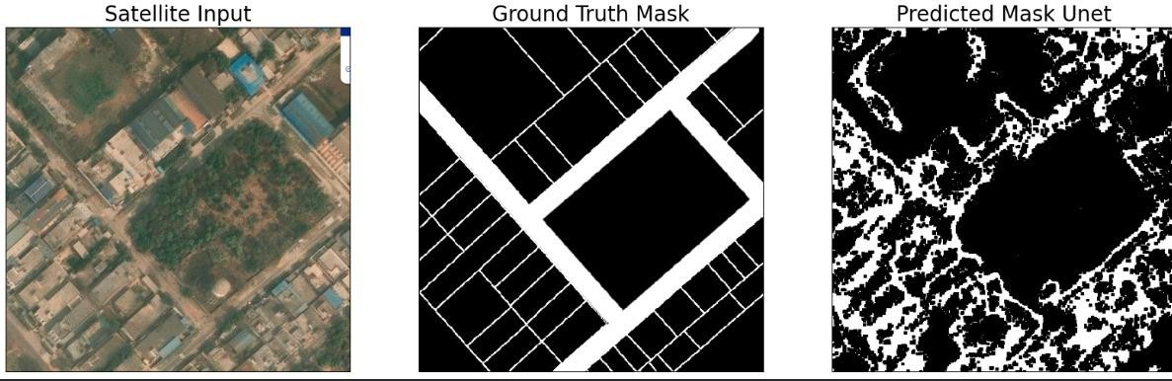
Results on U-Net (ResNet-50 encoder)
Satisfactory Results (visually)
Key Layout of the area is visible
Trained on multiple versions of labels and on multiple epochs to find the best model.
IoU Score: 0.52
Fig.14: Our implementation results

Slide 20
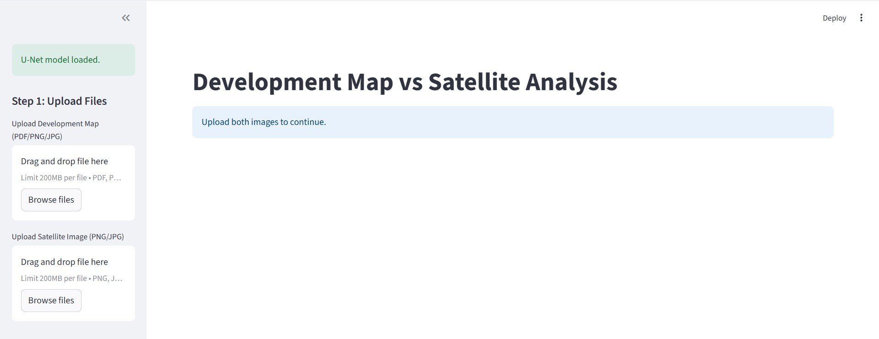
User Interface (Streamlit UI)
← Upload a development plan map.
← Upload satellite image for same area.

Slide 21
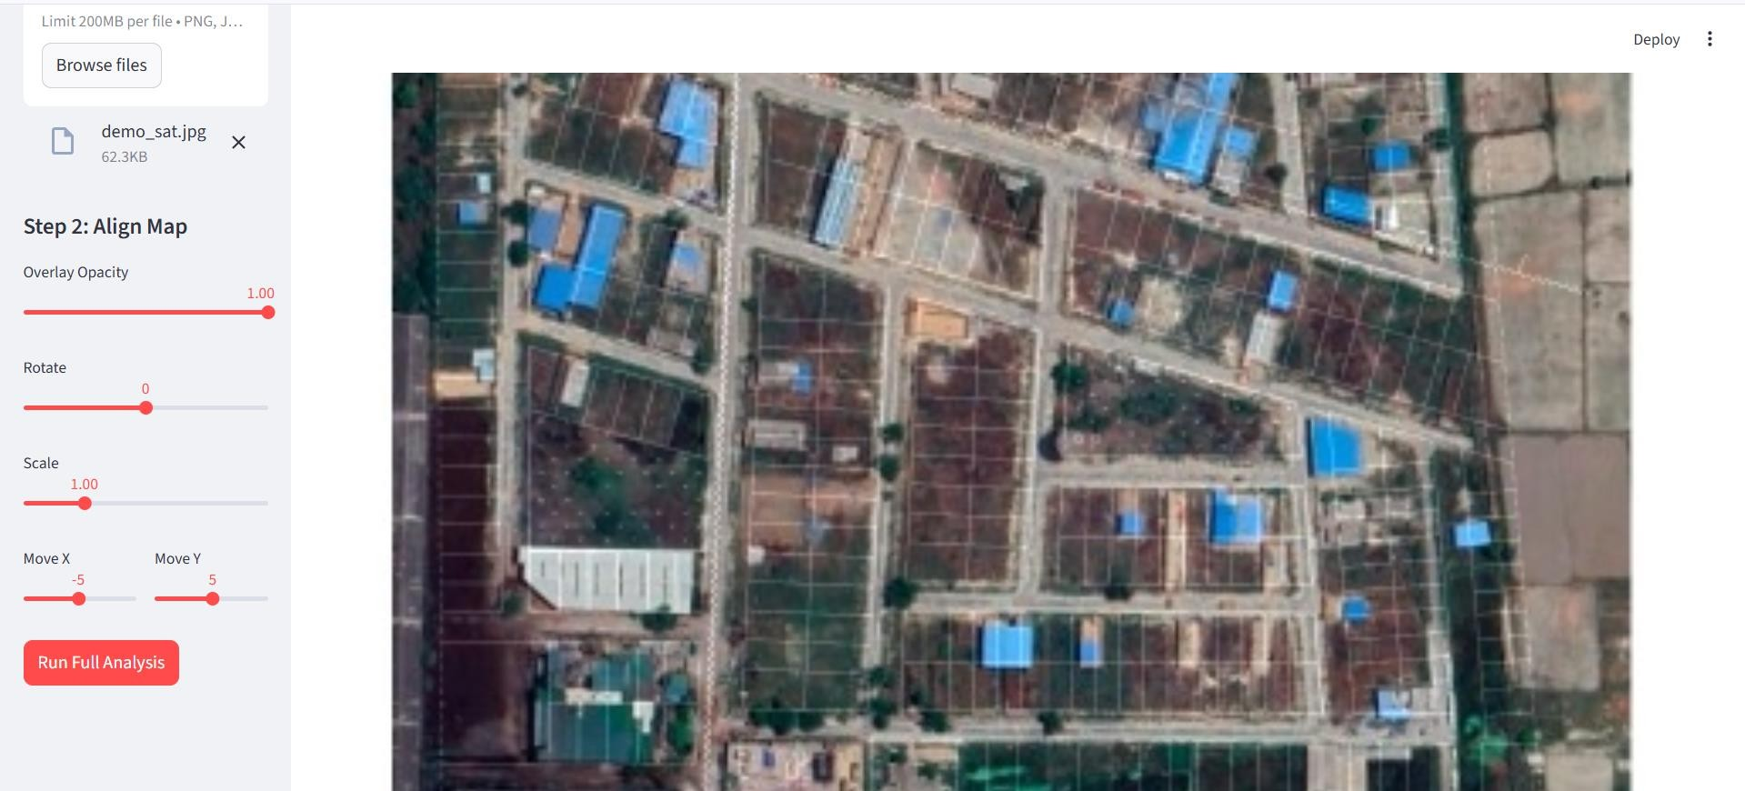
Use sliders to align the map and satellite image. Then Run full analysis.

Slide 22
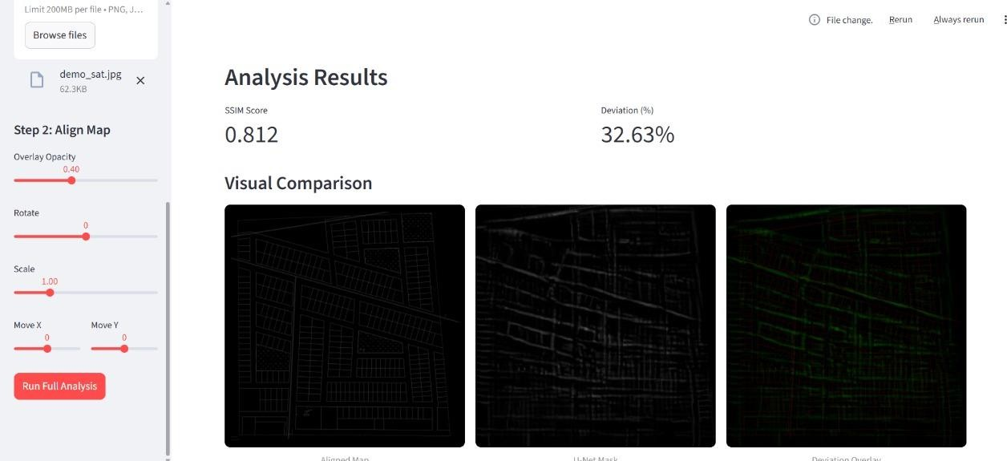
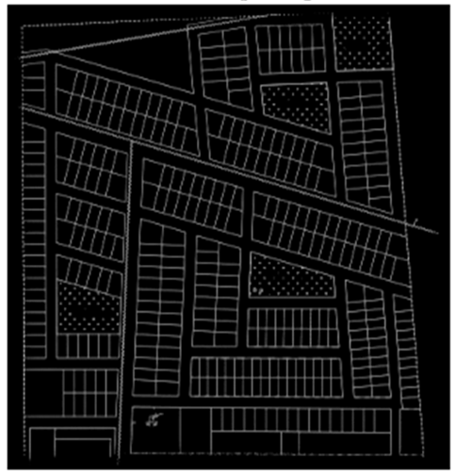

Slide 23
Results Summary
Approach | Achievements | Limitations | Reason
K-means & Grayscale | Great results on planned layouts | Fail in Satellite Images | Capture noise (Trees)
Direct comparision | Baseline Results | Worst results | No preprocessing
U-Net (On massachussets) | U-Net model Implement | Unsatisfactory Results | Not Ideal for Aligarh Satellite Images
U-Net (From Scratch) | U-Net model Implement | No output mask (Only black Pixels) | Learned majority class (i.e. Black Pixels)
Transfer Learning (Resnet50) | Best Results | Low IoU Score | Small Dataset

Slide 24
Results Summary
Urban Site Compliance deviation Levels:
Low: Atrauli Industrial Area, Etah IIDC
Moderate: Ozone City
High: Salempur
Algorithms and implemented codes are available in the following colab link.
https://colab.research.google.com/drive/14muegNdScXMjNGDx5VmnLSMaysSB9k8i

Slide 25
Limitations
Satellite resolution variation affects accuracy
Cloud cover challenges
Insufficient Labels to cover whole district (Only 53 images available)
Industrial vs Residential patterns differ

Slide 26
Conclusion
Our multi-approach AI framework
Detects unauthorized development
Supports data-driven policymaking
Promotes sustainable city planning
Tells how well the area is build based on development layouts.

Slide 27
Future Scope
Improve U-net model accuracy (By labelling more dataset images)
Real-time dashboard for authorities
Standardized regulations for thresholding
Improved UI for ease.

Slide 28
References:
Kmeans from V. Kharat and S. Khatdeo, "Land cover clustering and classification of satellite images.
For SSIM we have used “SAR Image Change Detection via Multiple- Window Processing with Structural Similarity” research paper by Minseok kang and Jaemin Baek.
For Unet we have used “URBAN CHANGE DETECTION BASED ON SEMANTIC SEGMENTATION AND FULLY CONVOLUTIONAL LSTMNETWORKS” by Maria Papadomanolaki and Maria Vakalopoulou.
Kaggle dataset: (https://www.kaggle.com/datasets/balraj98/massachusetts- buildings-dataset)
Layout maps from official UP Govt. Industrial Development website (UPSIDA): https://onemapup.nic.in/upsida/master.aspx

Slide 29
Thank You
We welcome questions from the panel.

